Slide 1
Introduction to Circos plots (2D)
Data Visualization Assignment
Luong Thi My Hanh

Slide 2
Main contents
Introduction
General functionality
Applications in Genomics
Vizualize relations
Others
https://jokergoo.github.io/circlize_book/book/introduction.html#a-qiuck-glance

Slide 3
Introduction

Slide 4
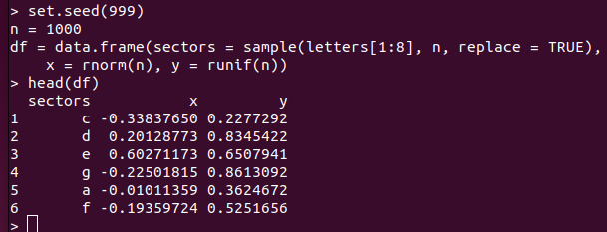
A simulated data

Slide 5
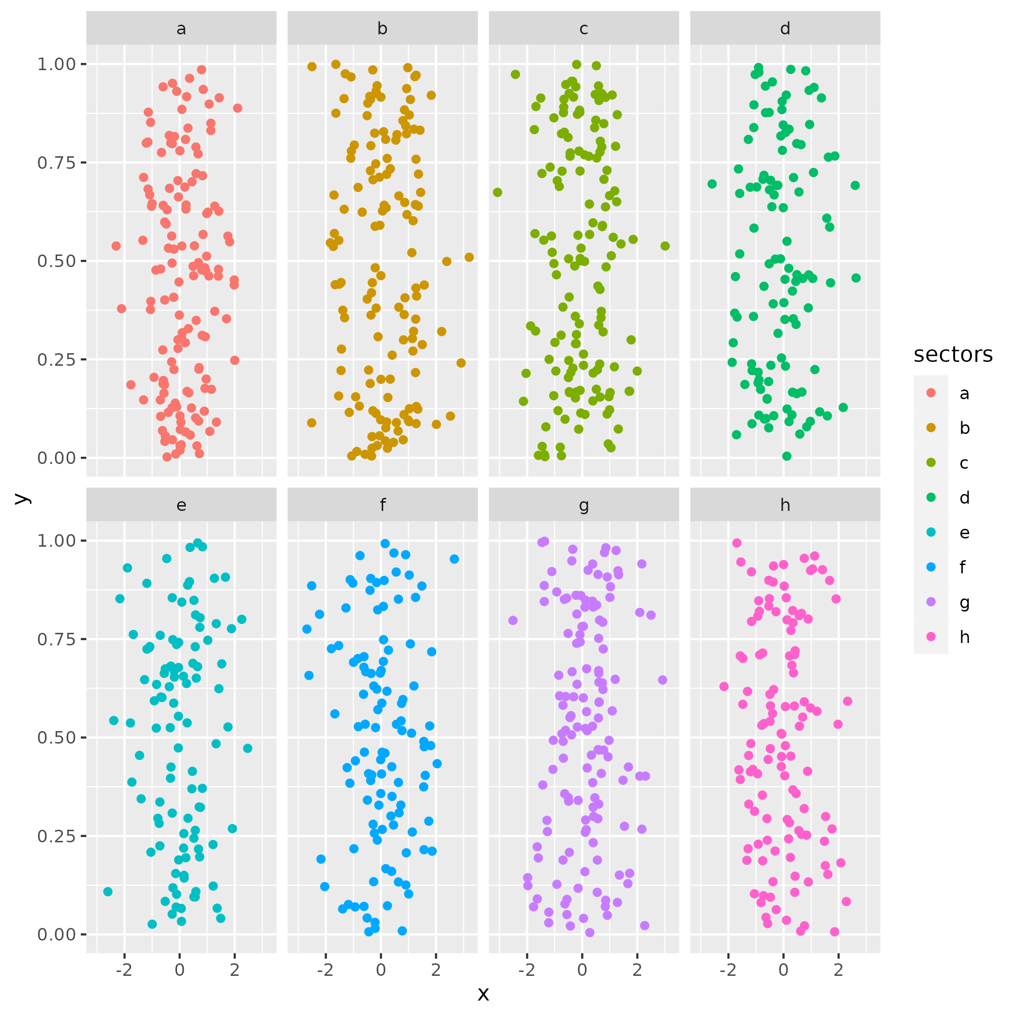
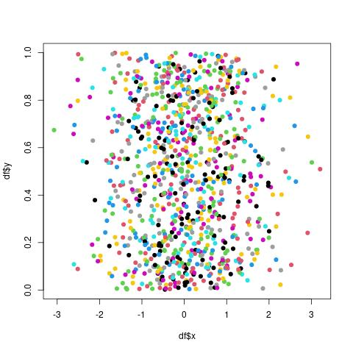
Visualization of each point (x,y) in sectors a-h

Slide 6
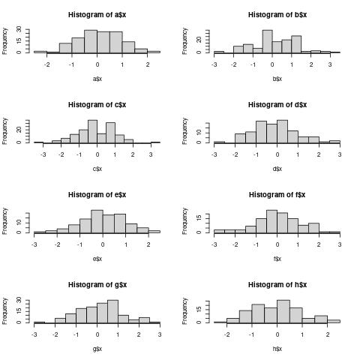

Slide 7
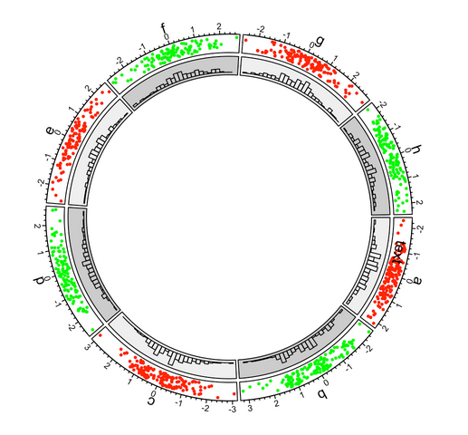
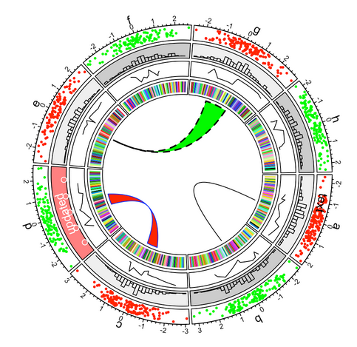

Slide 8
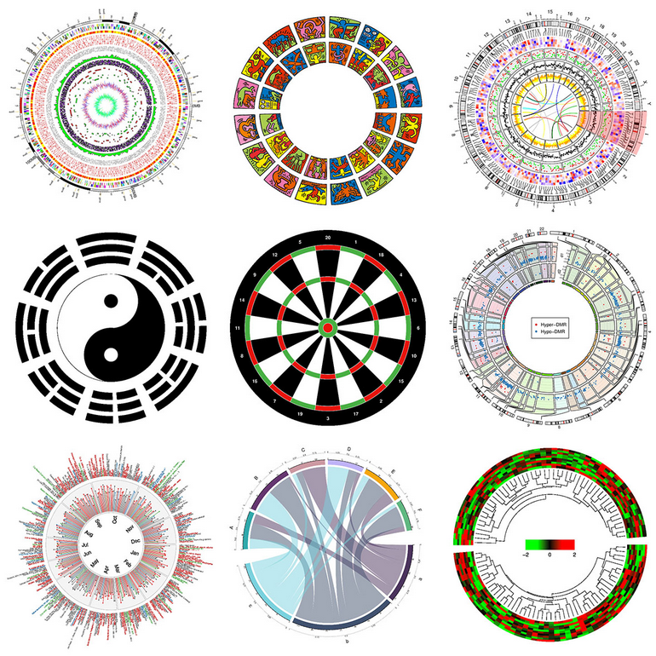

Slide 9
Circular layout, “circos plot”
large amount of categories
easily demonstrates relations between elements
R packages:
circlize, https://jokergoo.github.io/circlize_book/book/introduction.html#a-qiuck-glance
OmicCircos, https://bioconductor.org/packages/devel/bioc/vignettes/OmicCircos/inst/doc/OmicCircos_vignette.pdf

Slide 10
General functionality

Slide 11
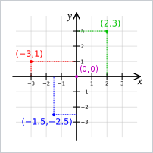
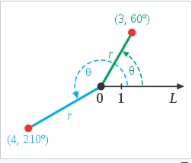
Circular layout: coordinate systems (2D)
Descartes coordinate system
polar coordinate system

Slide 12
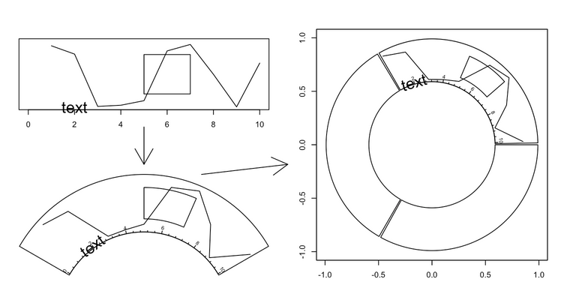
Circular layout: coordinate transformation
canvas coordinate system
data coordinate systems
(Descartes)
polar coordinate system

Slide 13
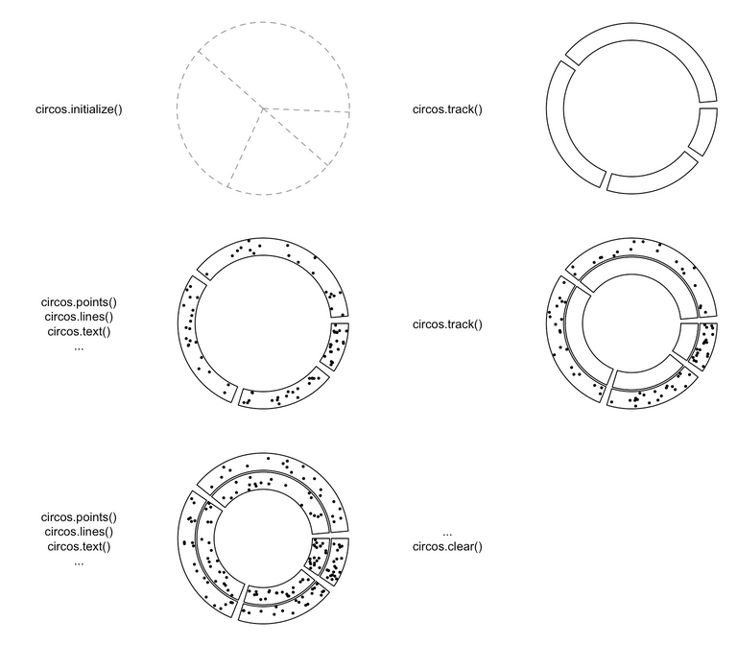
Circular layout: rules for making
initialize layout -> create track -> add graphics -> create track -> add graphics - ... -> clear
at least a categorical variable.
new track is inside previous one.

Slide 14
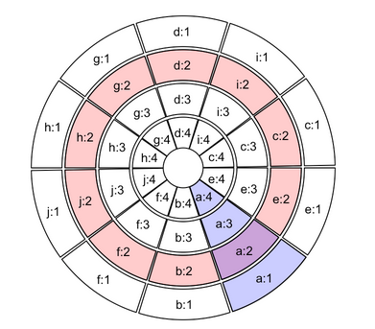
Circular layout: Sectors and tracks
red circle is one track
blue represents one sector
intersection of a sector and a track is called a cell

Slide 15
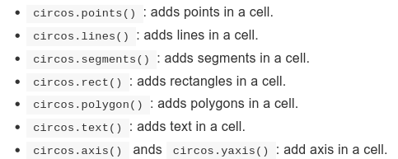
Circular layout: the functions for designing

Slide 16
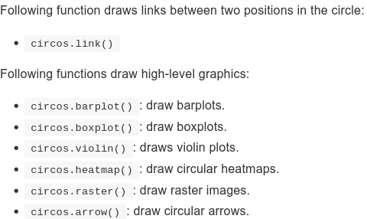
Circular layout: the functions for designing

Slide 17
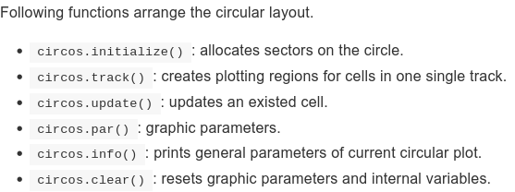
Circular layout: the functions for designing

Slide 18
Applications in Genomics

Slide 19
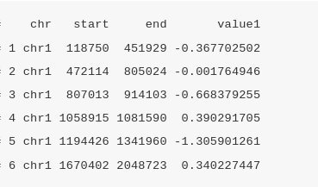
Data
high dimensional genomic data
categories are usually chromosomes and data on x axes are genomic positions
expect special format of input data: BED files

Slide 20
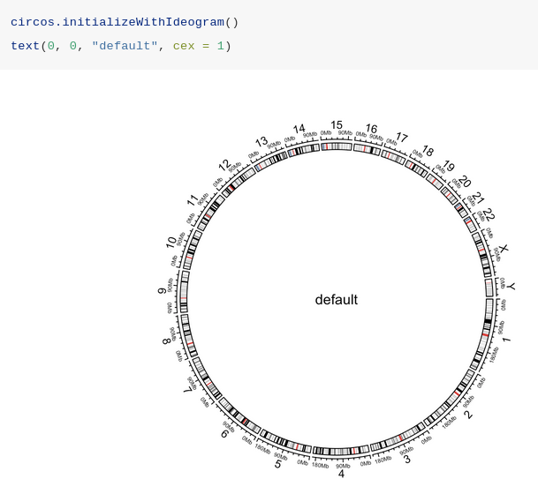
Functions

Slide 21
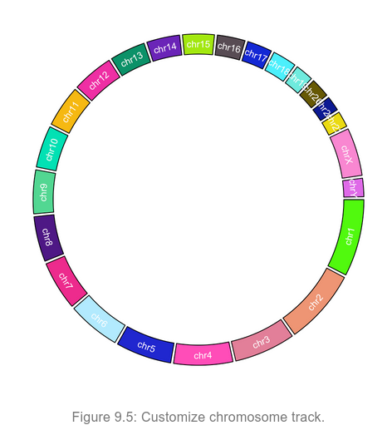

Slide 22
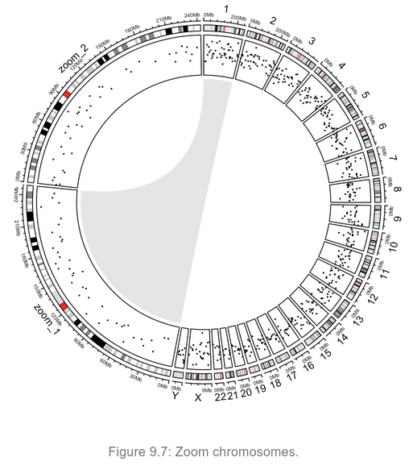

Slide 23
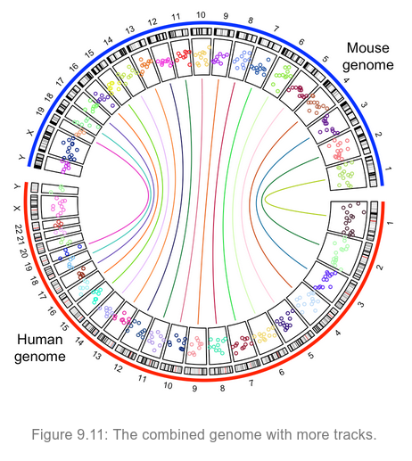

Slide 24
Visualize Relations: chordDiagram function

Slide 25
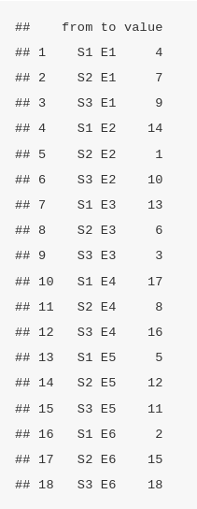
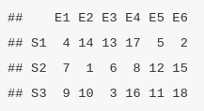
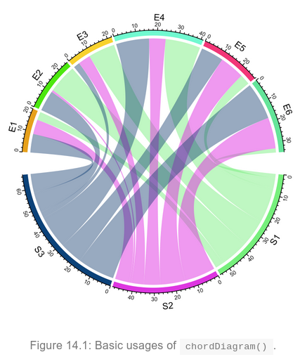
Simplest usage
Relation: from “S” to “E”

Slide 26
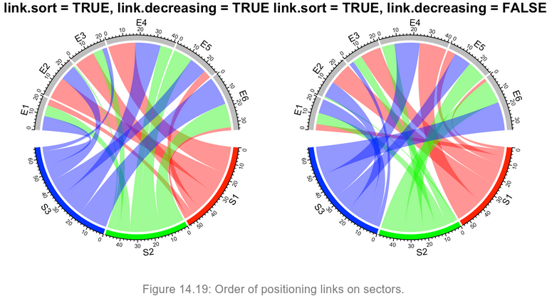
Simplest usage: orders of links

Slide 27
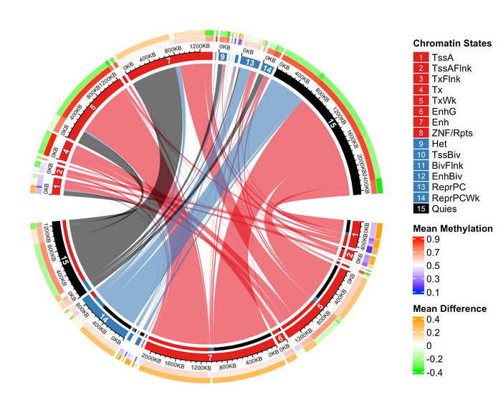
A complex example:

Slide 28
Others

Slide 29

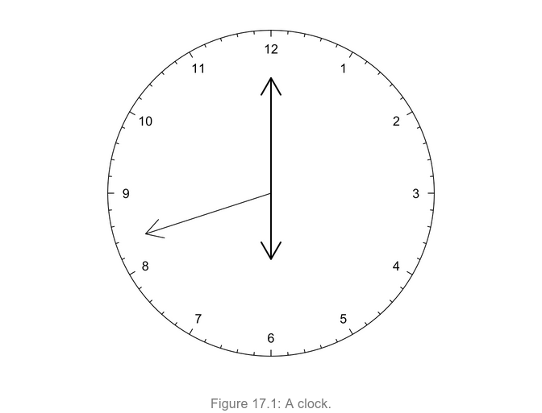
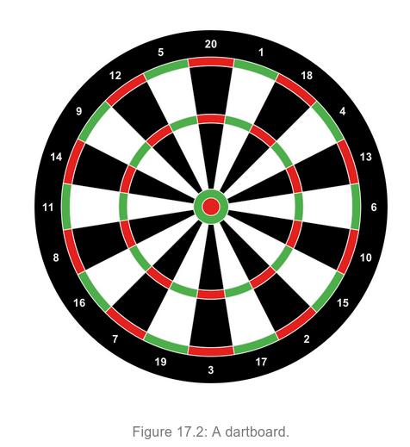

Slide 30
Practice

